Slide 1

Supply Chain Analytics
BY: Nashwa Atef

Slide 2
Problem
Inefficient supply chain monitoring leads to delays, cost overruns, and poor inventory management.
Solution
A centralized, real-time dashboard that provides visibility into key supply chain metrics like inventory levels, lead time, and supplier performance
Project Idea
Unique Value
Visual analytics for quicker decision-making, early anomaly detection, and data-driven optimization.

Slide 3
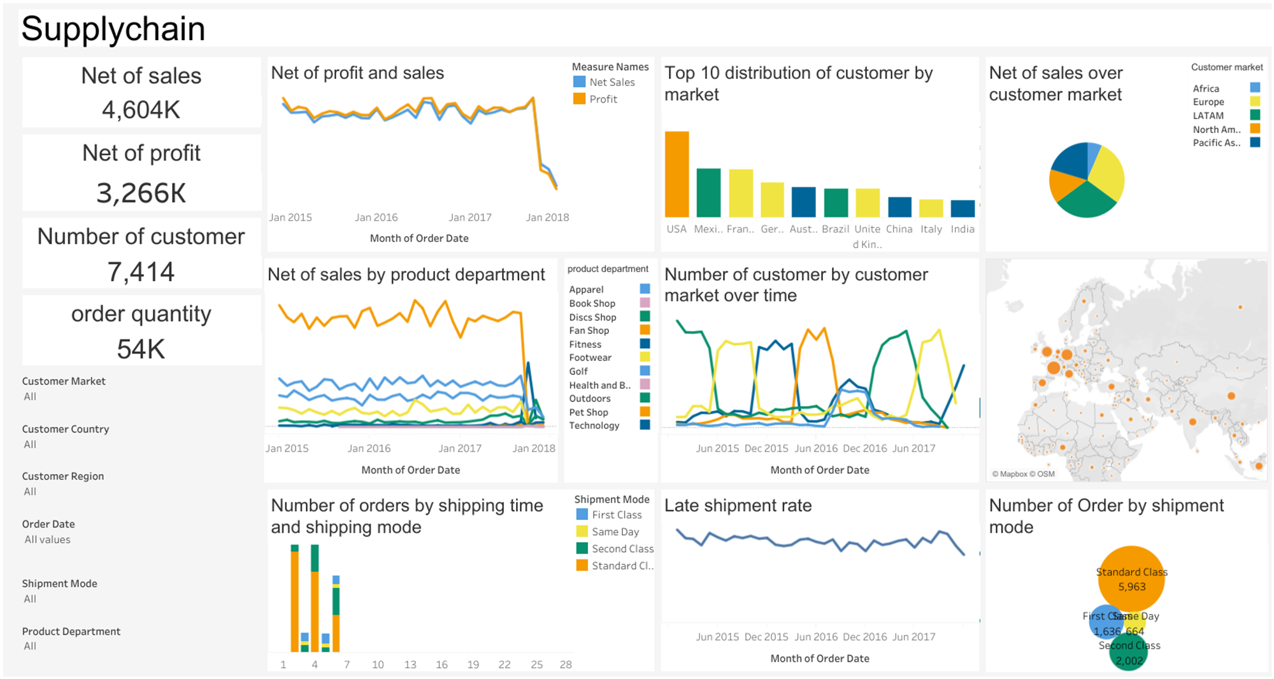
Login/Access dashboard
Filter by customer region, market, or product department
Explore KPIs: Profit, Sales, Orders, Shipment Modes
Analyze charts: Late shipment rate, Net sales over time, Shipping mode efficiency
Export reports or drill down for insights
Project Wireframe

Slide 4
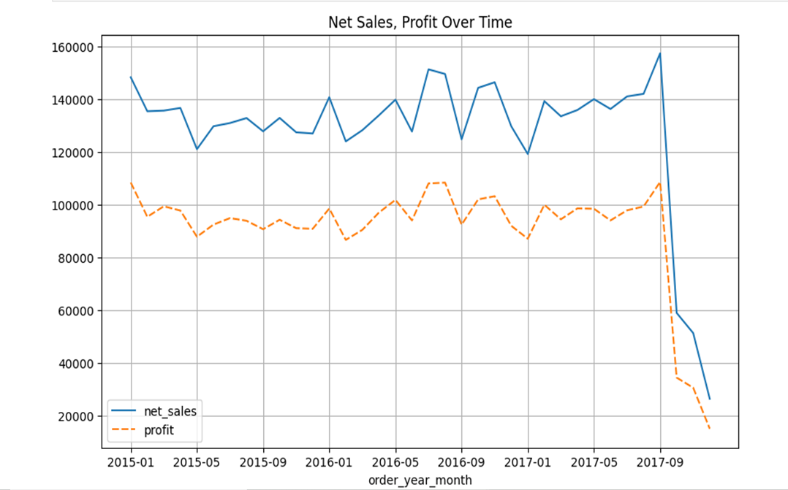
Framing questions related to revenue, product performance, and cost analysis
Business performance
MARS
Q4/2017 Performance declined : net sales and profit dropped significantly in Q4 2017, indicating a potential issue requiring investigation

Slide 5
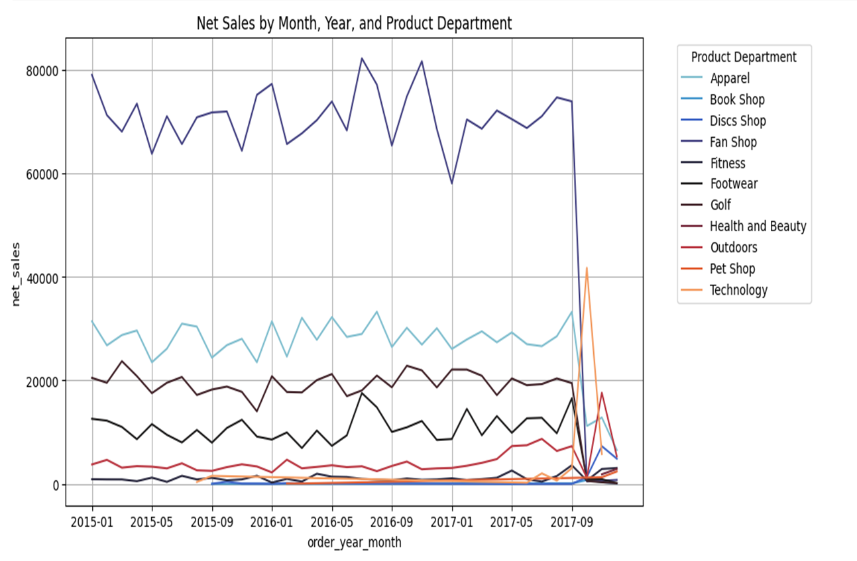
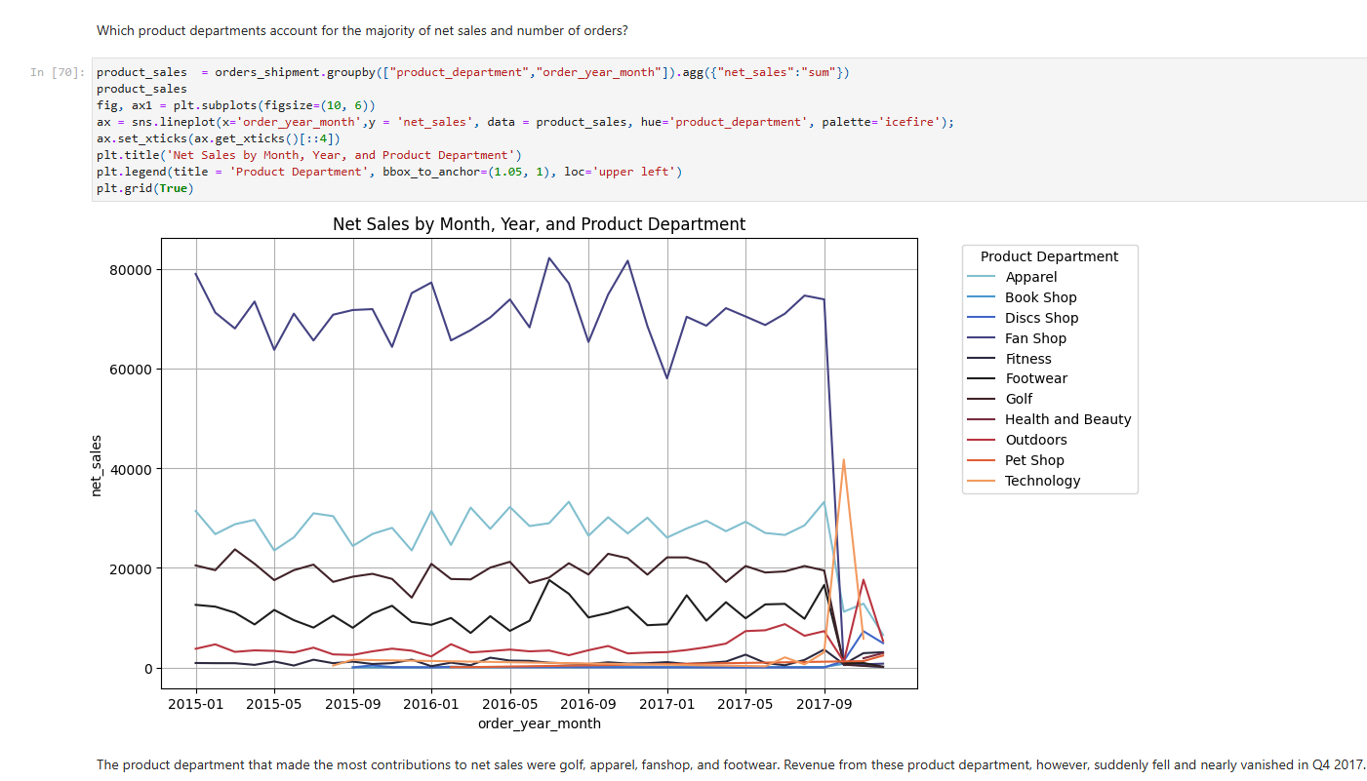


Orders and product performance
Apparel, Fanshop, Footwear and Golf which were instrumental to business’s success has suddenly plummeted and almost disappeared.
Meanwhile, the product departments such as Technology and Discs Shop showed potential growth

Slide 6
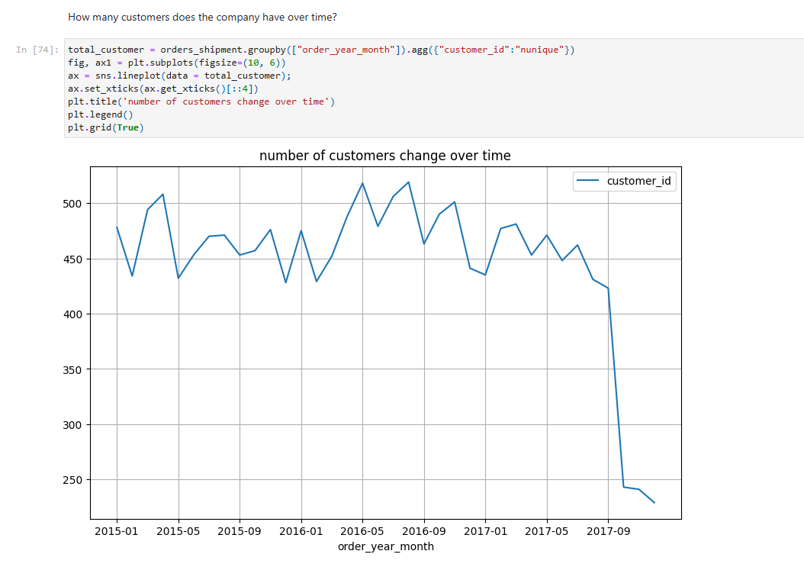

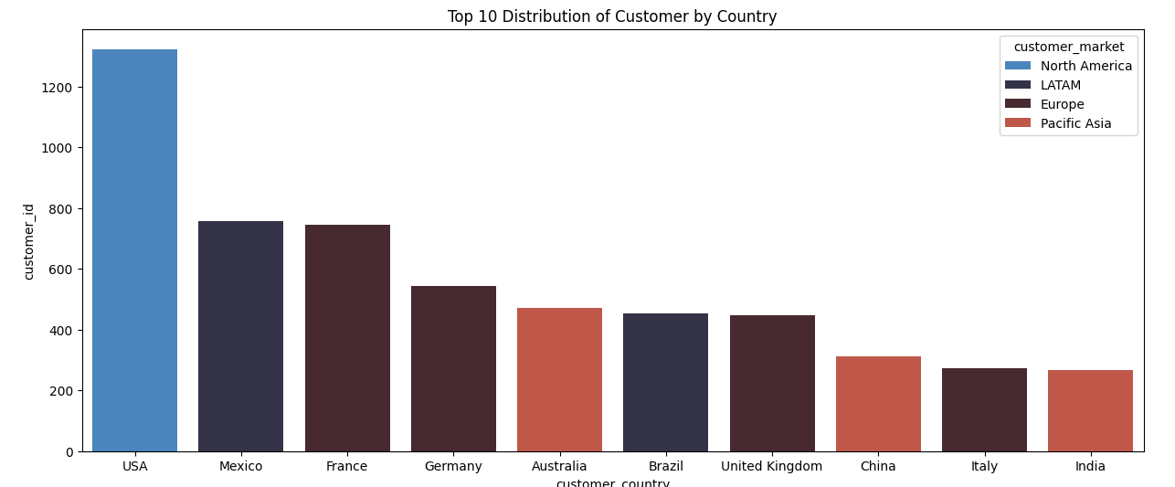
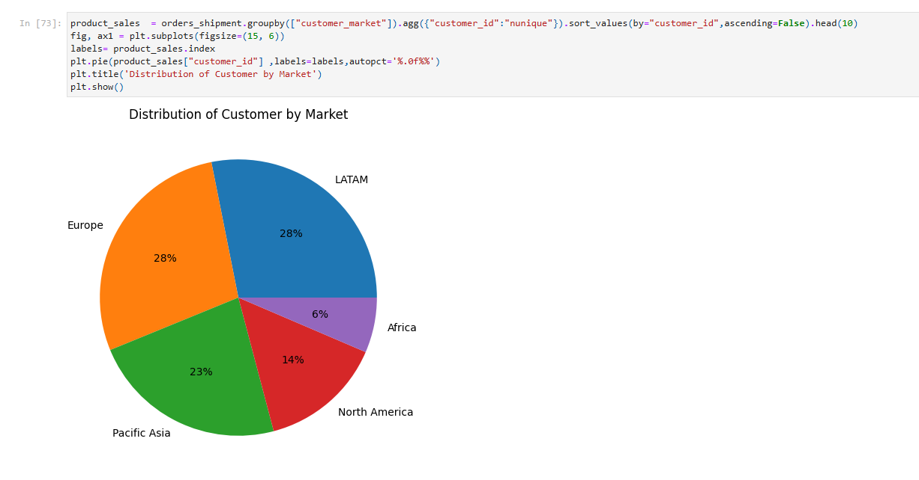
customer performance
USA have the highest customer
base ,but we saw a drop in customer number in Q4/2017

Slide 7
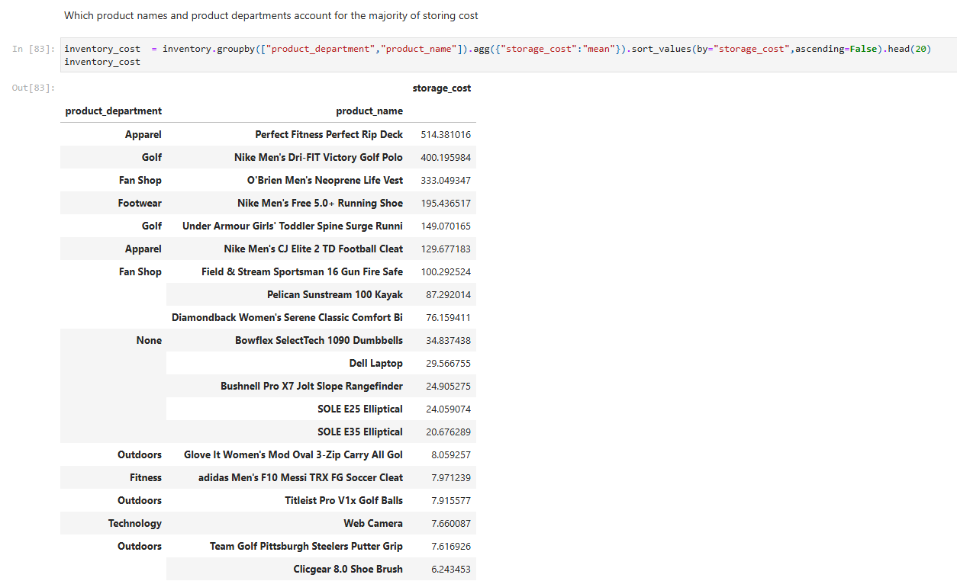
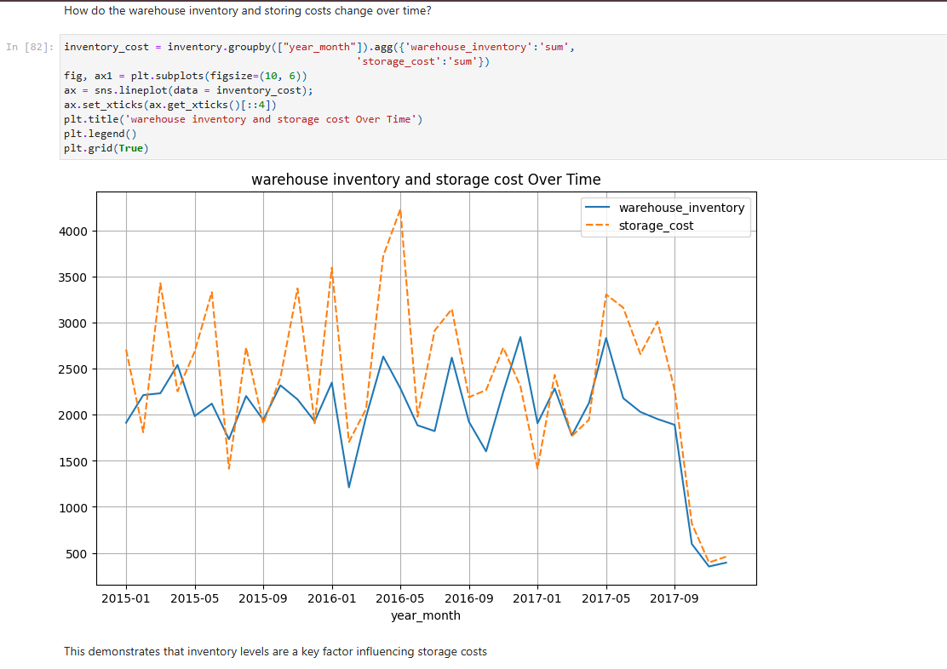
warhouse performance

Slide 8
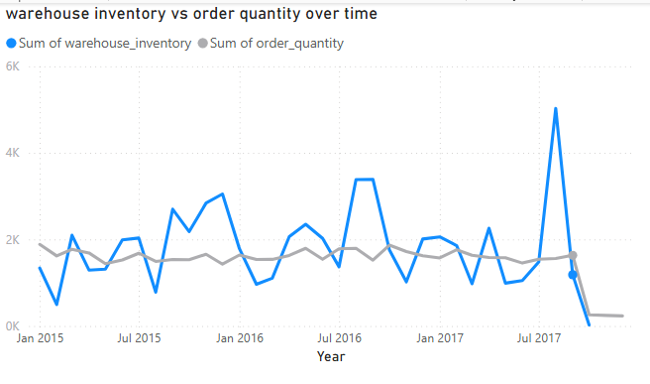
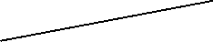

The company is frequently having excessive inventory or overstocked
Inventory fluctuates strongly at times, even though customers’ demand is quite stable
The company is facing the challenge of not being able to maintain a stable warehouse inventory to meet the ordering demand of customers

Slide 9
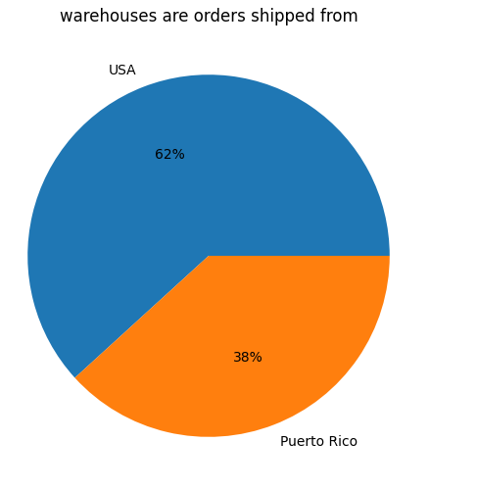
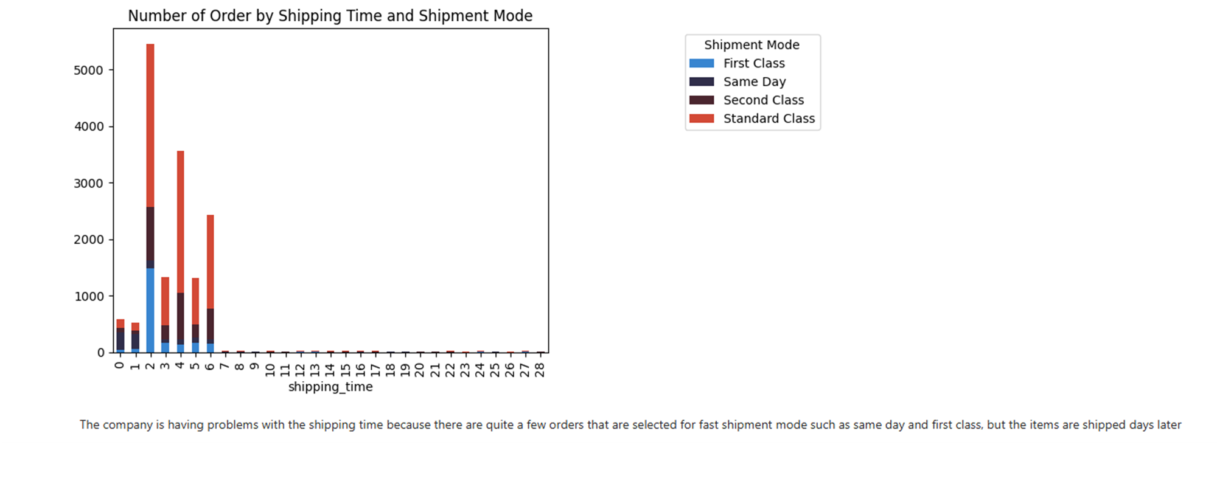
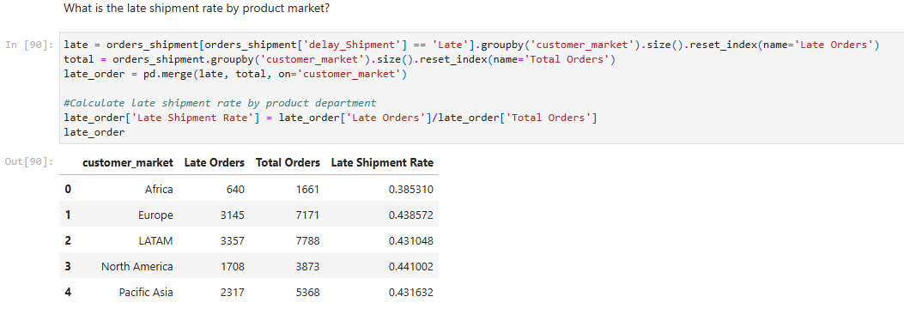
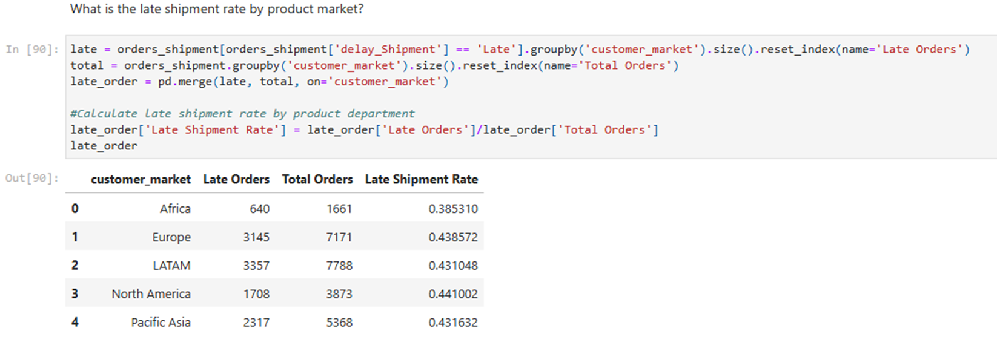
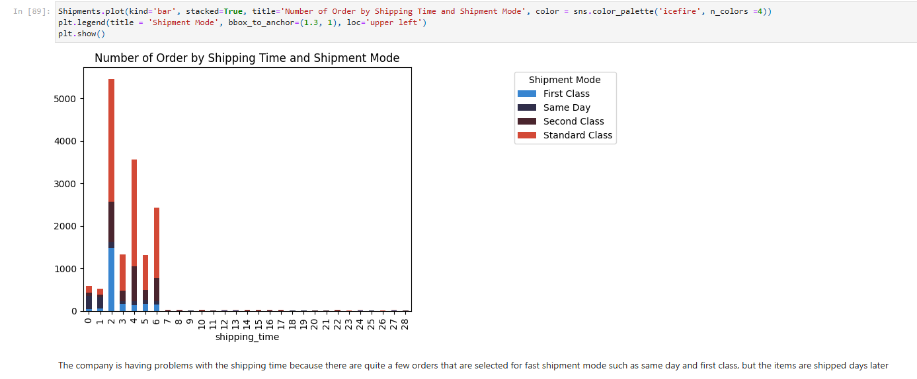
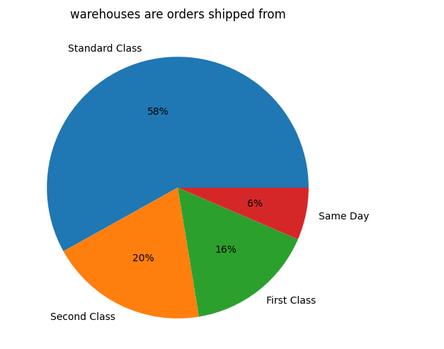
Shipping performance

Slide 10
The company is facing three main supply chain issues that need to be addressed
Supplier network disruption
Ineffective inventory management
Overstock and understock
Supply chain inefficiencies
Ineffective shipment system
High late
shipment rate

Slide 11
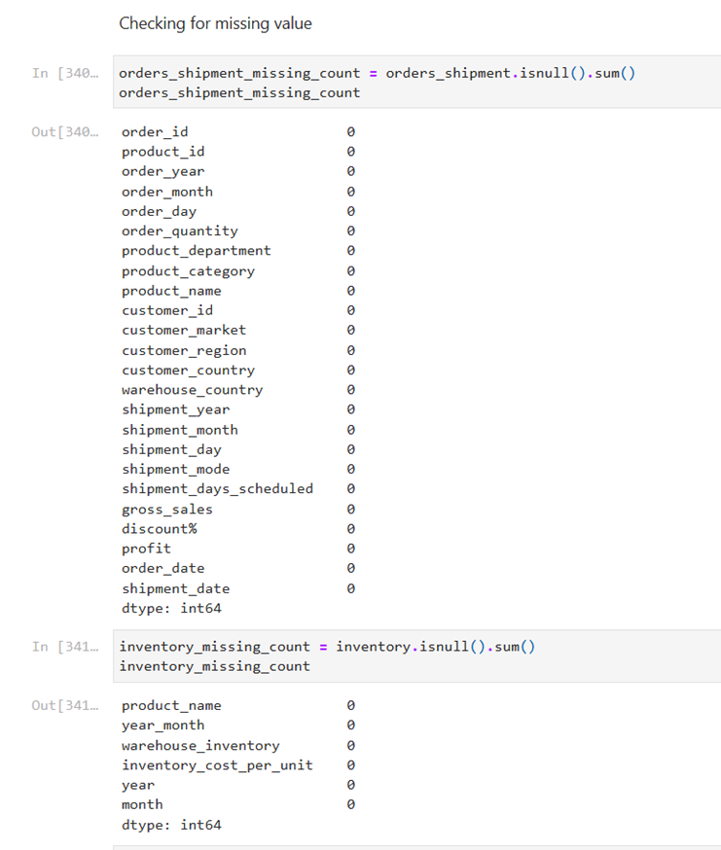
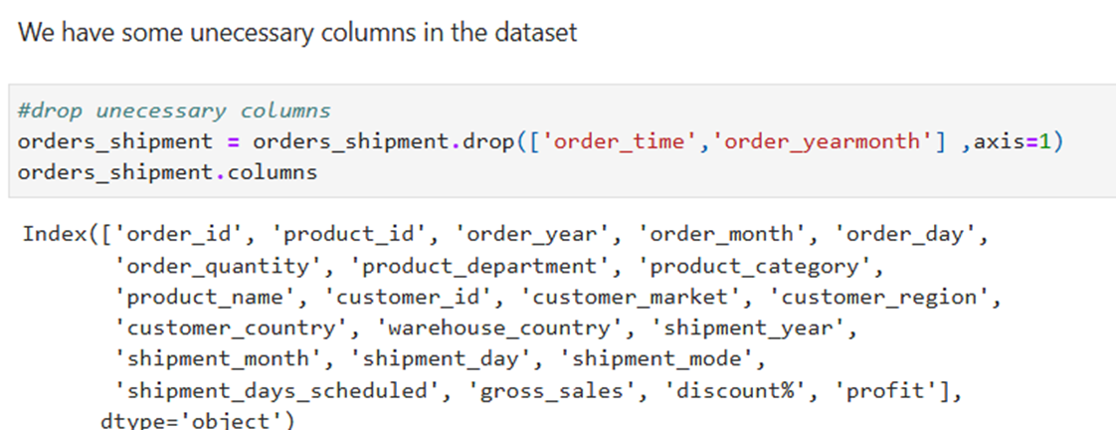
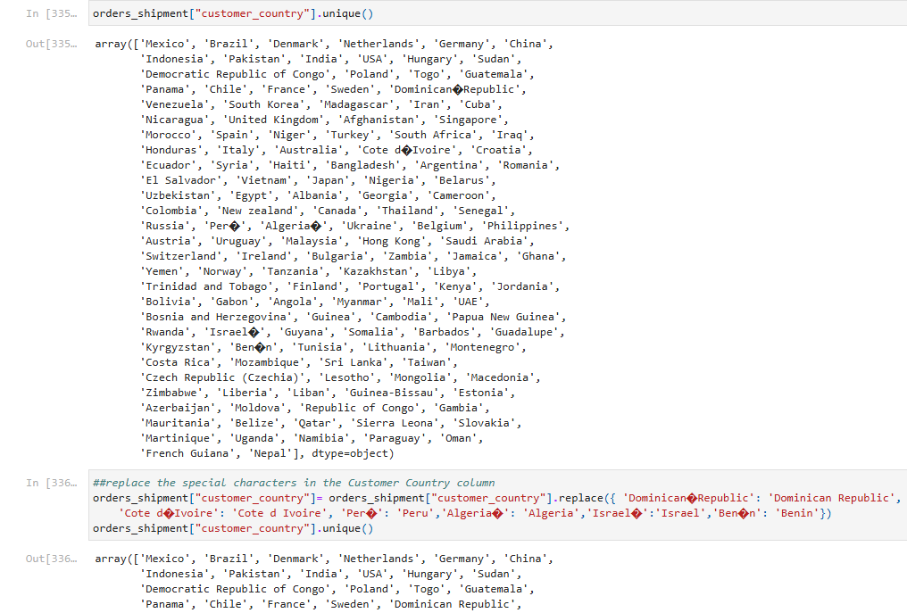
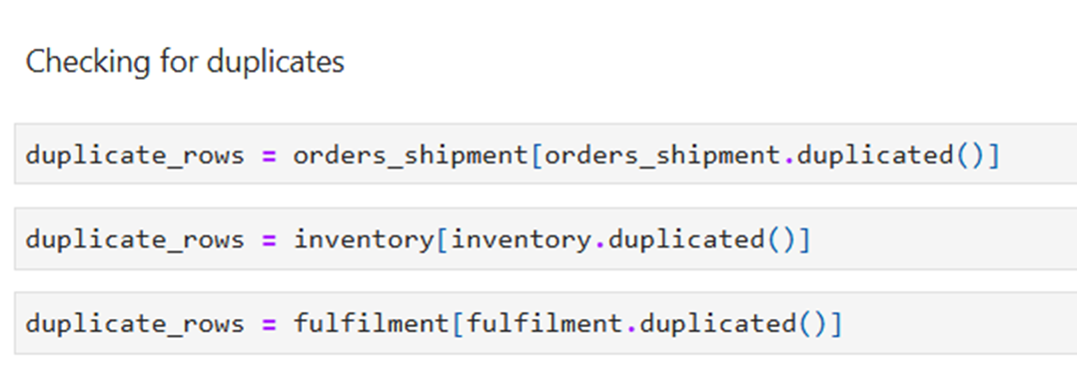
Data structure
Data quality improvement : we ensured data accuracy and consistency by addressing missing values, duplicates and errors . This provides a reliable foundation for analysis

Slide 12
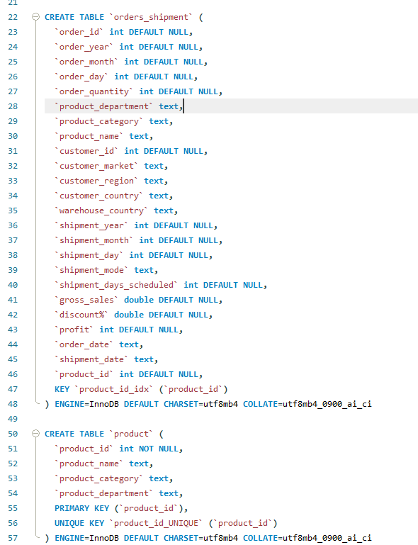
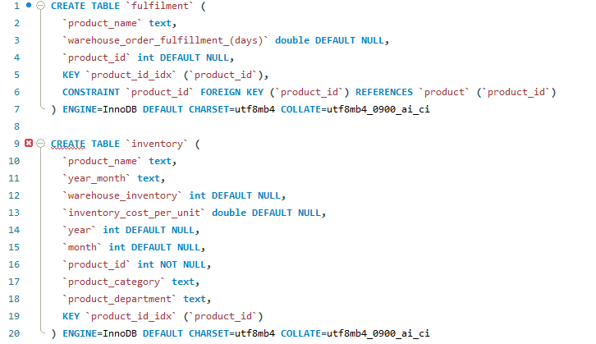
Data structuring : the data was organized for efficient analysis of customer performance , orders and product performance

Slide 13
Deliverables
01
project milestone
Data Preparation
02
03
Insight generation
forecasting
04
presentation and reporting

Slide 14
01
Data Preparation
Excel ,VsCode jupternotebook pyhton(pandas,numby)
Deliverables
working app
02
Insight generation
VsCode VsCode jupternotebook
pyhton(seaborn, matplotlib)
03
forecasting
tableau
04
presentation and reporting
Power piont , tableau, power bi

Slide 15
About
Raw data set
Cleaned data set
Tableau dashboard
Powerbi dashboard

Slide 16

Thank you
Contact info
Email: nashwaatef20@gmail.com

